Slide 1
Resampling part II Tree based methods
Resampling - Bootstrap
Decision trees
Bagging
Random forests
Boosting

Slide 2
Introduction – resampling I
What is resampling? Which methods did we mention so far?

Slide 3
Introduction – resampling I
What is resampling? Which methods did we mention so far?
A: Validation set, Cross validation
What are they good for?

Slide 4
Introduction – resampling I
What is resampling? Which methods did we mention so far?
A: Validation set, Cross validation
What are they good for?
A: Approximation of real model error (error when tested on the entire population)
Why is CV better than validation set approach? –draw on board
Why is 5-fold CV better than LOOCV? –draw on board
Notes:
CV over validation set: treniramo na “punom setu” opažanja, varijabilnost greške je velika ovisno o tome kako podijelimo podatke
5fold better then LOOCV: veća varijanca, manja pristranost (bias) za k manji.

Slide 5
The bootstrap
Example: Choose 1000 people from population and measure their height. What is the mean? If we choose another 1000 people and measure their height, how far would it be from first mean?
How would you find confidence interval for this mean?

Slide 6

The bootstrap
How would you find confidence interval for this mean? Ideas?

Slide 7
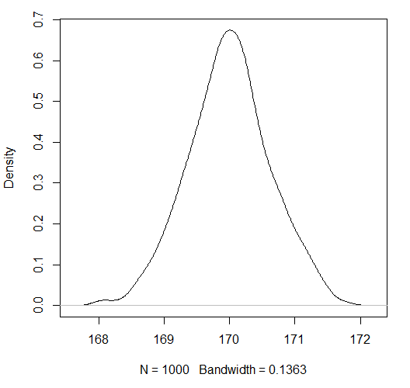
The bootstrap
How would you find confidence interval for this mean
Get 1000 samples from the population 1000 times!
PROBLEM?

Slide 8
The bootstrap
How would you find confidence interval for this mean
Make 1000 samples of same size by sampling with replacement from the original sample! =BOOTSTRAP
WHY DOES THIS MAKE SENSE?
Confidence interval built this way is called bootstrap percentile confidence interval.
Notes:
Observations that are clustered around the meanare picked more frequently than outliers so they give more „weigth”
IID = independent, identically distributed

Slide 9
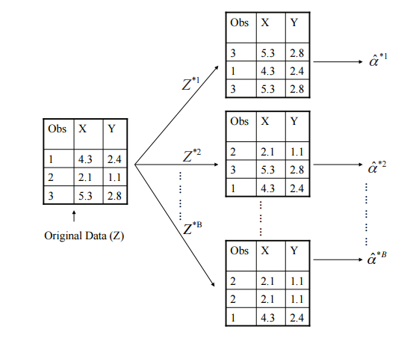
The bootstrap
How would you find confidence interval for this mean?
Example with 3 samples:

Slide 10
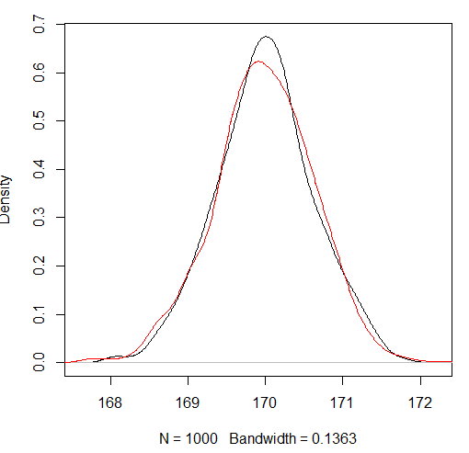
The bootstrap
Results
in red:

Slide 11
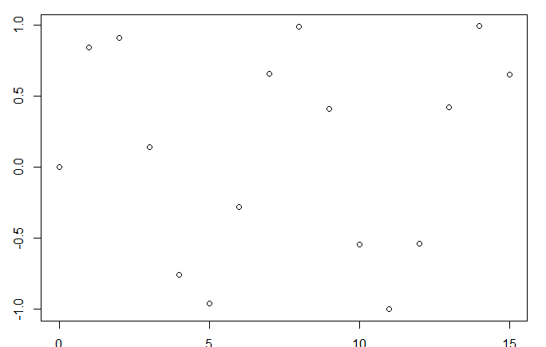
It is so simple! ..Right?
Be careful:
Time series – can we sample?
Notes:
Problem – data is not independent

Slide 12
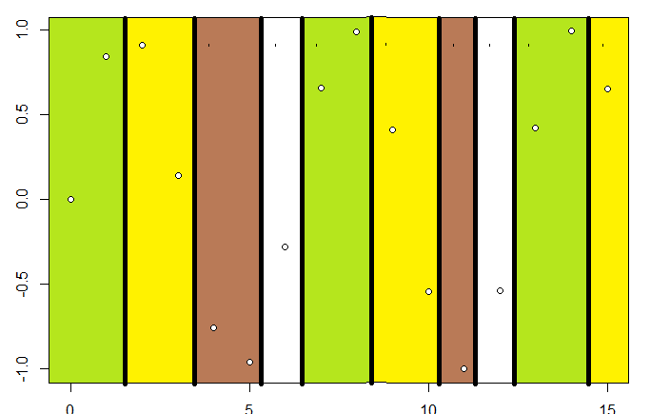
It is so simple! ..Right?
Be careful:
Time series - blocks of consecutive observations
- A1A2A3A4B1B2B3B4C1C2… -> A1B2A3C4B1A2B3C4…
Notes:
Find the parts of the data that are uncorrelated and make new blocks 1-2-3-4 from any 1 2 3 4 blocks!

Slide 13
It is so simple! ..Right?
Be careful:
Q: Can the bootstrap estimate prediction error?
Compared to cross validation, what is the difference?
What is the problem? And the solution?
Notes:
2/3 of original points appear in any bootstrapped sample. – fix?
Fix – remove overlaps, test on „new”. – true fix – use cv instead.

Slide 14
The bootstrap
It is very useful when null (background) distribution is not known
Be careful how you use it

Slide 15
Tree based methods

Slide 16
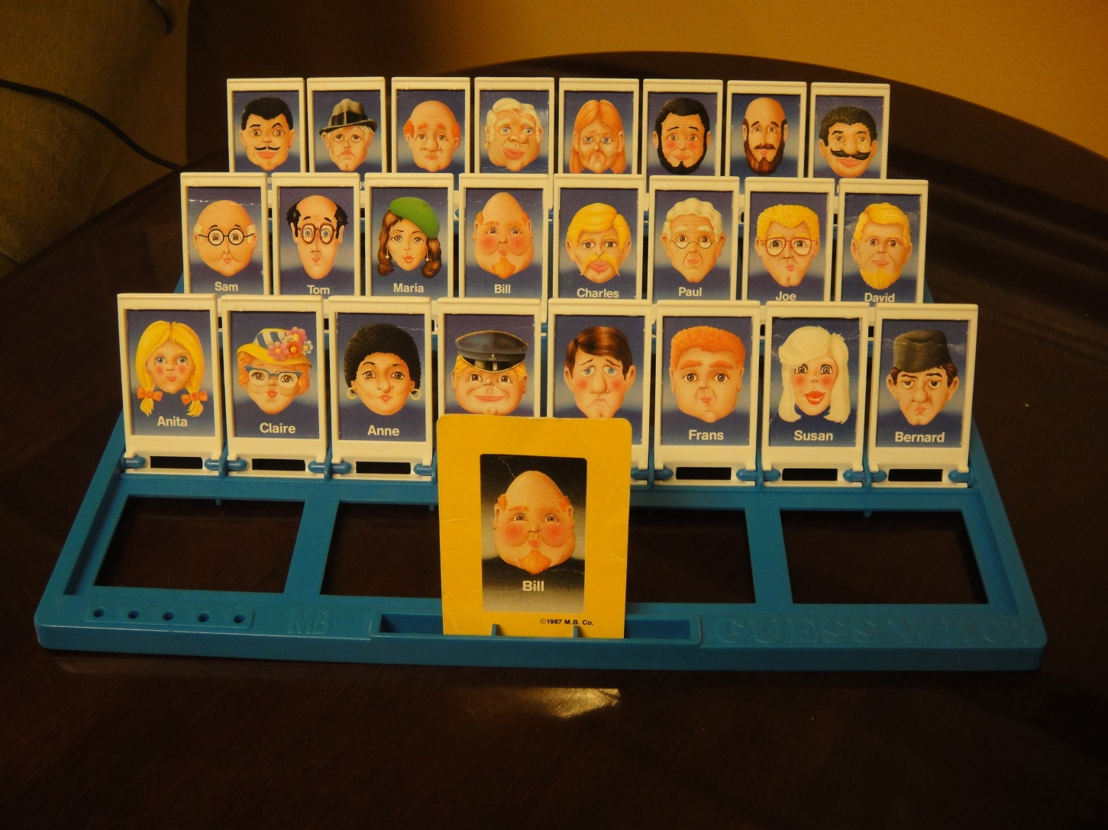
Decision trees

Slide 17

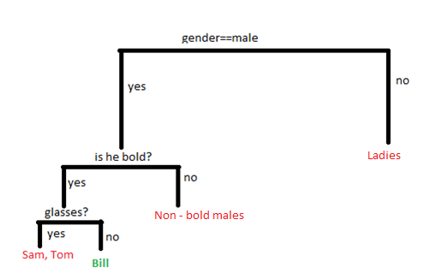
Decision trees
 | gender | isBold | longHair | hat | galsses | blondHair
Sam | male | yes | no | no | yes | no
Tom | male | yes | no | no | yes | no
Maria | female | no | yes | yes | no | no
Bill | male | yes | no | no | no | no
Charles | male | no | no | no | no | yes
Paul | male | no | no | no | yes | no
Joe | male | no | no | no | yes | yes
David | male | no | no | no | no | yes
Anita | female | no | yes | no | no | yes
Claire | female | no | yes | yes | yes | no
Anne | female | no | no | no | no | no
X | male | no | no | yes | no | yes
Y | male | no | no | no | no | no
Frans | male | no | no | no | no | no
Susan | female | no | yes | no | no | no
Bernard | male | no | no | yes | no | no

Slide 18
Decision trees
Terminology:
Classification tree
3 internal nodes
4 terminal nodes = leafs, they represent the mean of the response for the observations that fall there.

Slide 19
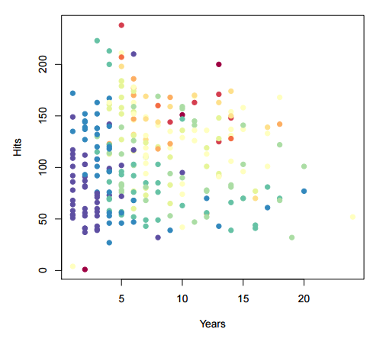
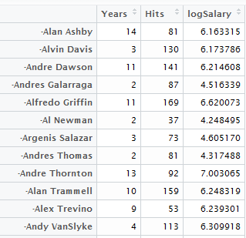
Decision trees
Hitters
Notes:
1.) What is their true salary if this is log salary?
2.) Why did we color by log salary instead of true salary?

Slide 20
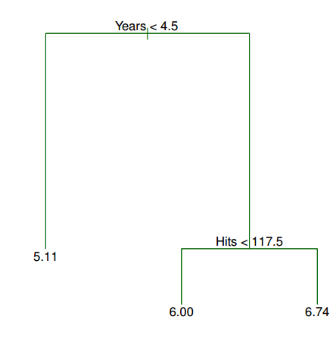
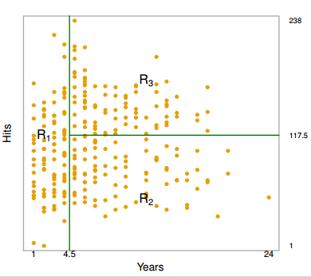
Decision trees
Notes:
an over-simplification, but compared to a regression model, it is easy to display, interpret and explain

Slide 21
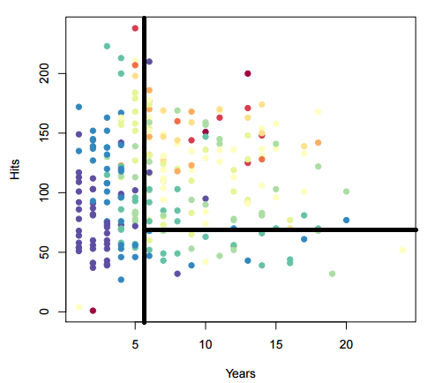
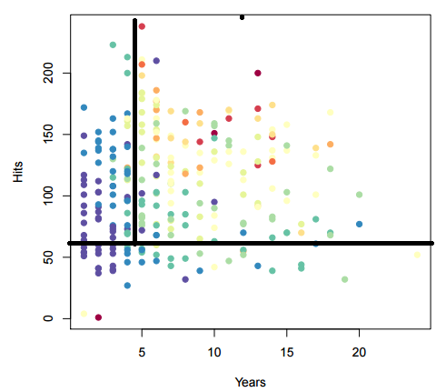
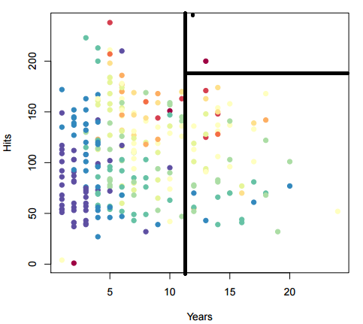
How to build a tree? – General idea
Divide predictor space into J distinct and nonoverlaping boxes.
. . .
Possible division 1
Possible division 2
. . .
Possible division n

Slide 22


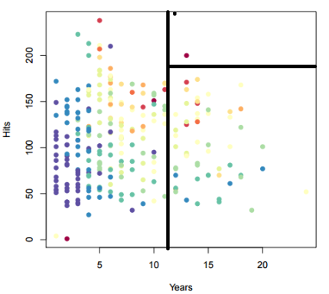
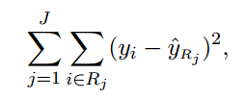
How to build a tree? – General idea
. . .
Possible division 1
Possible division 2
. . .
Possible division n
Which division is better? – use RSS
The goal is to find boxes R1, . . . , RJ that minimize the RSS, where ˆyRj is the mean response for the training observations within the jth box
Notes:
- What is y??

Slide 23
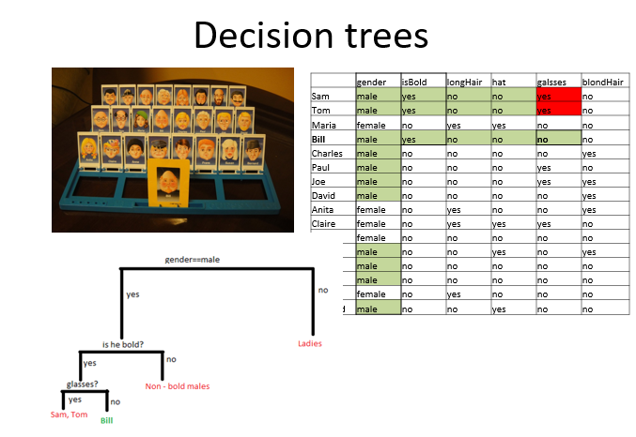
How to build a tree? – General idea
Are there not too many possible partitions? – binary splitting approach:
Top down : begin at the top and act successively
greedy : don’t look ahead
First ask about the gender because it will filter out most subjects in most cases.
Notes:
The approach is top-down because it begins at the top of the tree and then successively splits the predictor space; each split is indicated via two new branches further down on the tree. • It is greedy because at each step of the tree-building process, the best split is made at that particular step, rather than looking ahead and picking a split that will lead to a better tree in some future step.

Slide 24
Building a tree in details (1,2,3)
Select a predictor and cutpoint such that that split will lead to greatest reduction in RSS
Repeat within defined regions
Stop at some point. (for example when a region after the next splitting would contain less than 5 observations)
Predict response for new data using this tree as a model.

Slide 25
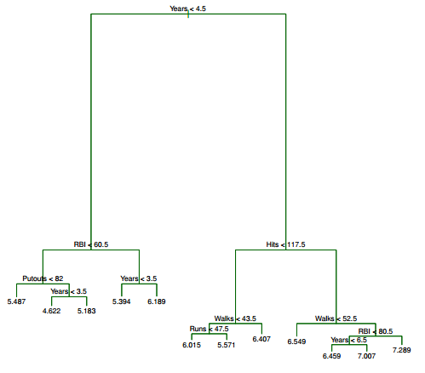
Problem: overfitting.
Example:
Try the model on me
me
Lower salary

Slide 26
Ideas?
Example:
Try the model on me
me
Lower salary

Slide 27
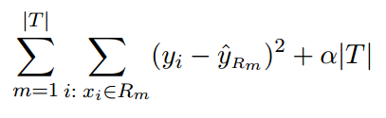
Solution: pruning
Pay a cost for complexity:
Select optimal α by cross validation

Slide 28
Summary: tree algorithm
Use recursive binary splitting to grow a large tree on the training data, stopping only when each terminal node has fewer than some minimum number of observations.
Apply cost complexity pruning to the large tree in order to obtain a sequence of best subtrees, as a function of α.
Use K-fold cross-validation to choose α. For each k = 1, . . . , K:
Repeat Steps 1 and 2 on the K−1 K th fraction of the training data, excluding the kth fold.
Evaluate the mean squared prediction error on the data in the left-out kth fold, as a function of α. Average the results, and pick α to minimize the average error.
Return the subtree from Step 2 that corresponds to the chosen value of α.

Slide 29
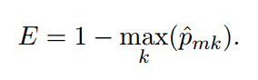
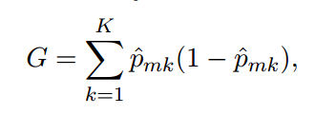
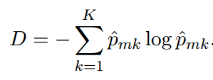
Classification trees – no RSS
Classification error rate - not sufficiently sensitive.
Gini index – a measure of node „purity”
Conclude by formula
– which is better- larger or smaller G?
Cross entropy – similar to gini index.
Notes:
Here ˆpm
a measure of total variance across the K classes. The Gini index takes on a small value if all of the ˆpmk’s are close to zero or one. • For this reason the Gini index is referred to as a measure of node purity — a small value indicates that a node contains predominantly observations from a single class. k represents the proportion of training observations in the mth region that are from the kth class.

Slide 30
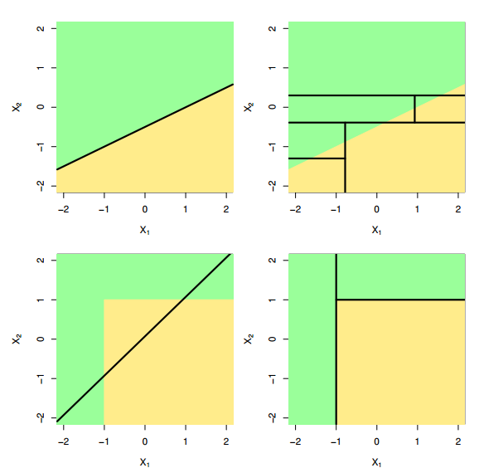
Trees vs linear models

Slide 31
Advantages and Disadvantages
+ easy to explain
+ mirror human decision making
+ easy interpretation and display
+ easily handle qualitative predictors
- Are not as accurate as other regression and classification approaches

Slide 32
Bagging bootstrap aggregation

Slide 33
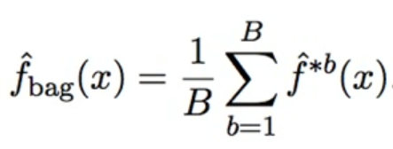
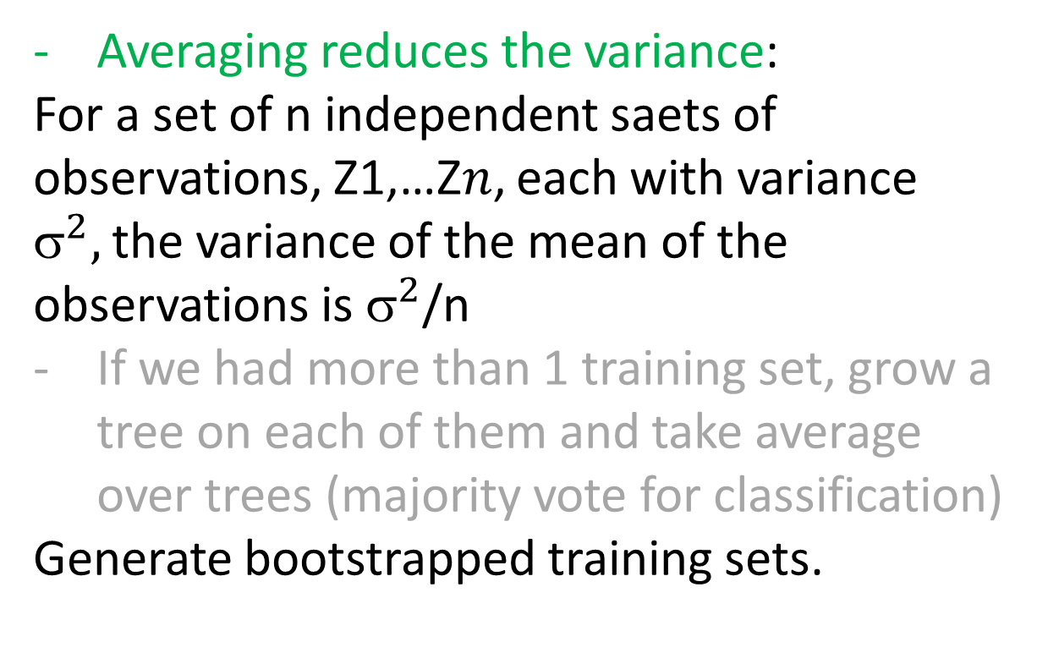
Bagging
Averaging reduces the variance:
For a set of n independent saets of observations, Z1,…Z$n$, each with variance ${\text{}}^{2},$the variance of the mean of the observations is ${\text{}}^{2}$/n
If we had more than 1 training set, grow a tree on each of them and take average over trees (majority vote for classification)
Generate bootstrapped training sets.

Slide 34
Random Forests

Slide 35
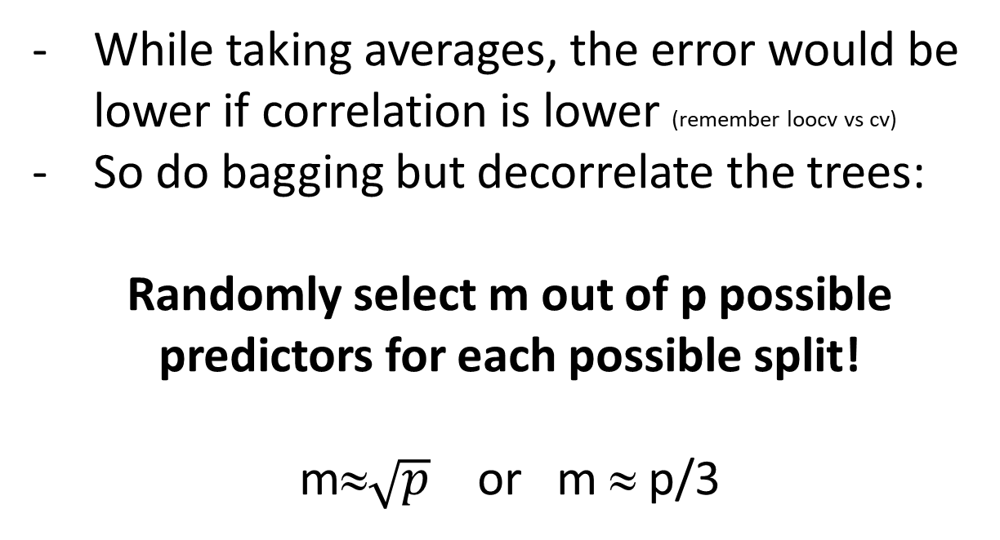
Random Forests
While taking averages, the error would be lower if correlation is lower (remember loocv vs cv)
So do bagging but decorrelate the trees:
Randomly select m out of p possible predictors for each possible split!
m≈$\sqrt{p}$ or m ≈ p/3
Notes:
If a good predictor is left out, it will have many chances to be chosen. (i have a problem with this, same as lasso if there are lots of correlated predictors!!)

Slide 36
Out of Bag Error Estimation
Straightforward way to estimate the error of a bagged model
Make a tree using 2/3 observations, predict on the remaining 1/3= out of bag observations
Average over trees

Slide 37
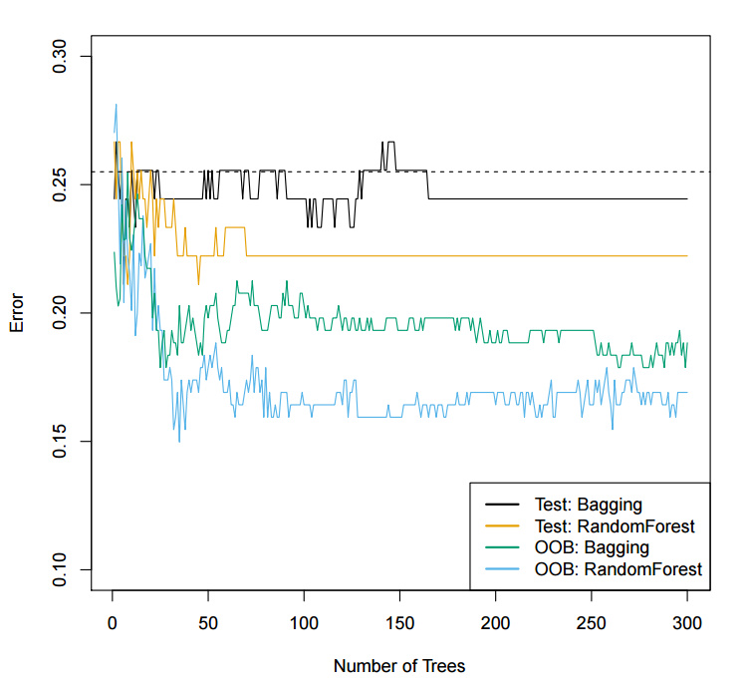
Prediction errors on Heart dataset with bagging and random forests
Notes:
Bagging and random forest results for the Heart data. • The test error (black and orange) is shown as a function of B, the number of bootstrapped training sets used. • Random forests were applied with m = √p. • The dashed line indicates the test error resulting from a single classification tree. • The green and blue traces show the OOB error, which in this case is considerably lower

Slide 38
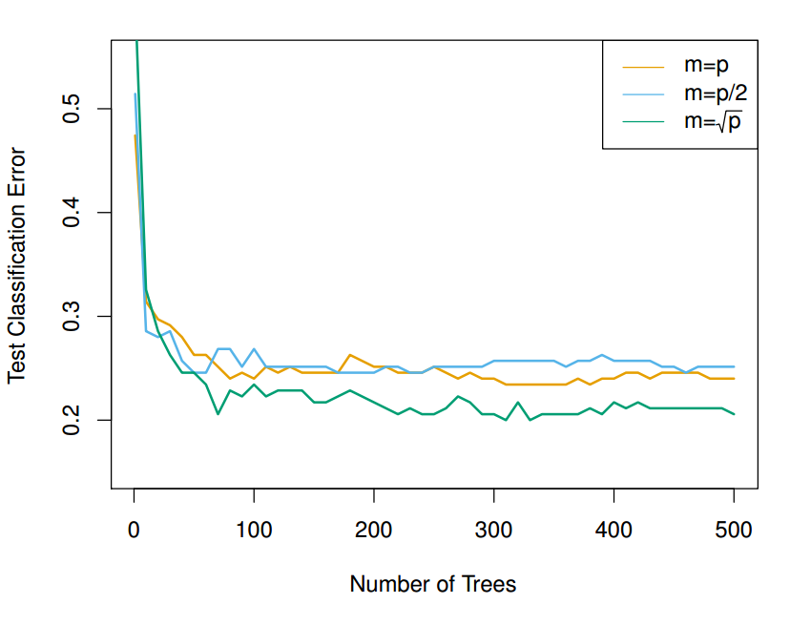
OOB errors for deciding on number of trees and predictors (m)
Notes:
More trees won’t overfit

Slide 39
Boosting

Slide 40
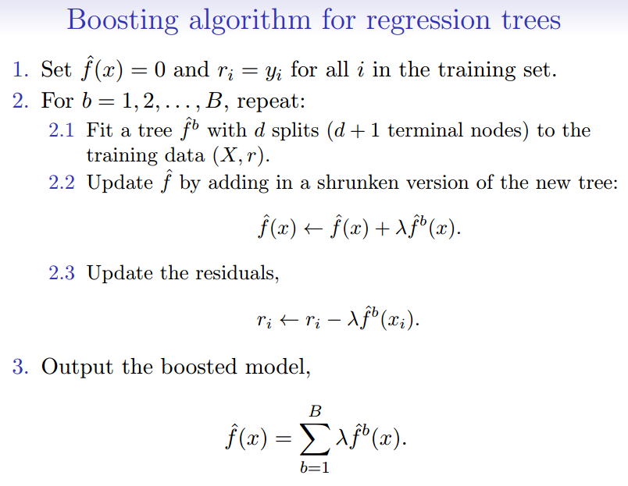
Boosting
- Trees are added sequentially to improve performance of the previous collection of trees
Notes:
More trees won’t overfit

Slide 41
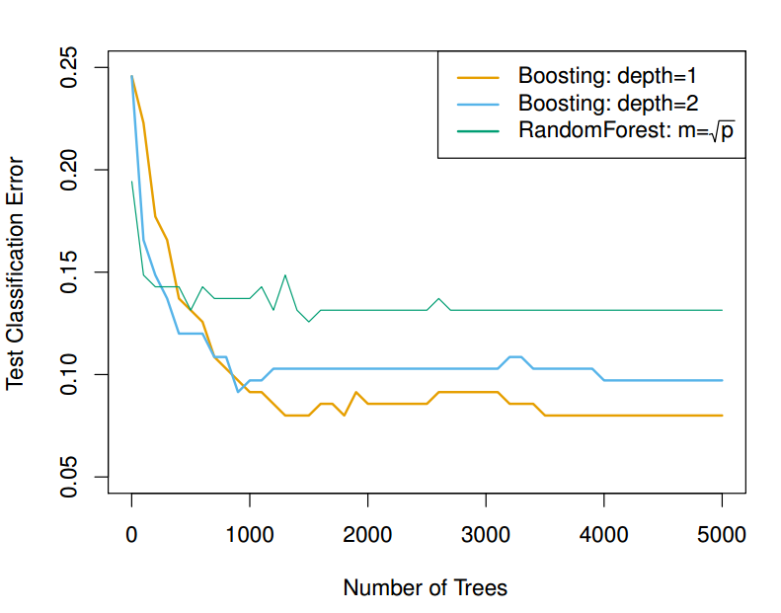
Boosting
Fit very slowly so there is no overfitting
Boosting can also be done for classification.
(details Elements of Statistical Learning, chapter 10)
Notes:
• Results from performing boosting and random forests on the fifteen-class gene expression data set in order to predict cancer versus normal. • The test error is displayed as a function of the number of trees. For the two boosted models, λ = 0.01. Depth-1 trees slightly outperform depth-2 trees, and both outperform the random forest, although the standard errors are around 0.02, making none of these differences significant. • The test error rate for a single tree is 24%.

Slide 42
Tuning parameters for boosting
The number of trees B. Unlike bagging and random forests, boosting can overfit if B is too large, although this overfitting tends to occur slowly if at all. We use cross-validation to select B.
The shrinkage parameter λ, a small positive number. This controls the rate at which boosting learns. Typical values are 0.01 or 0.001, and the right choice can depend on the problem. Very small λ can require using a very large value of B in order to achieve good performance.
The number of splits d in each tree, which controls the complexity of the boosted ensemble. Often d = 1 works well, in which case each tree is a stump, consisting of a single split and resulting in an additive model. More generally d is the interaction depth, and controls the interaction order of the boosted model, since d splits can involve at most d variables.

Slide 43
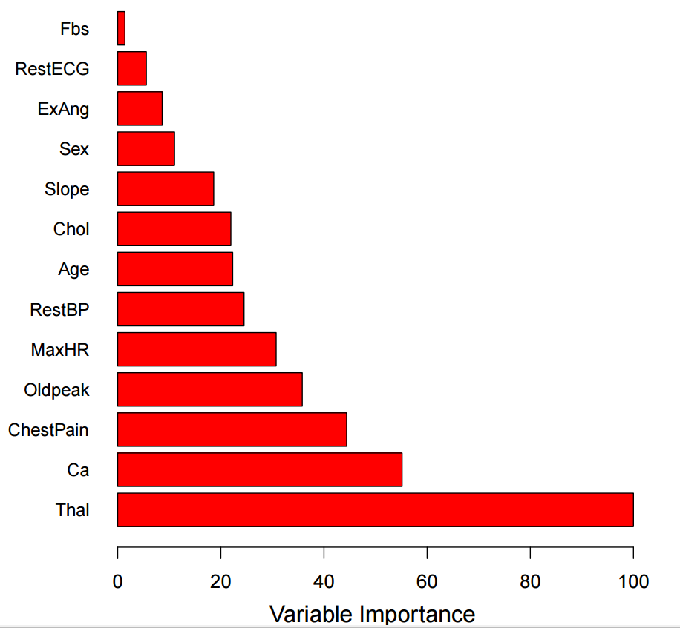
Variable importance measure
For bagged / RF trees, we record the total amount that the RSS (Gini indeks for classification trees) is decreased due to splits over a given predictor, averaged over all B trees. (the higher the better)

Slide 44
What to do (and what not)

Slide 45
Choosing from predictor space
We apply random forests to a high dimensional biological data set containing expression measurements of 4718 genes measured on tissue samples from 349 patients.
Each sample is either normal or labeled as 1 of 14 types of cancer.
We choose set of 500 predictors that have the highest variance in the training set and build random forest to predict cancer type.
Are we cheating?
Notes:
We are doing unsupervised screening so it is not a problem.

Slide 46
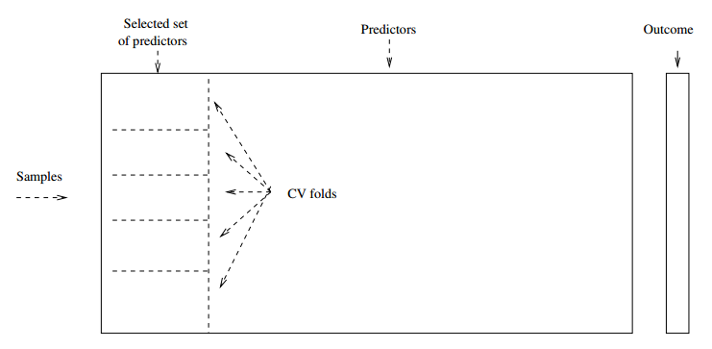
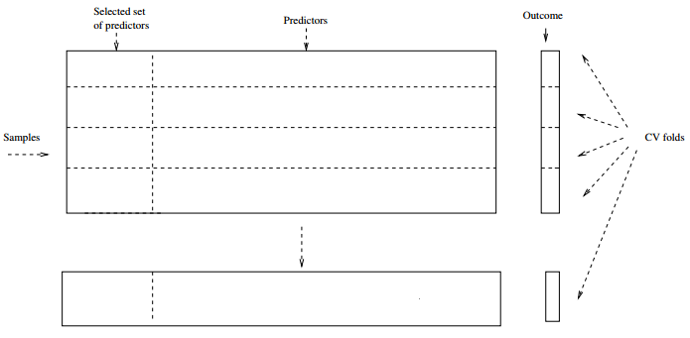
What NOT to do

Slide 47
Example 2
Large data set: 630730 genes in patients with liver cirrhosis and 578064 genes in healthy people.
Around 20 variables extrapolated from our data set: M and A values for some statistic, on different levels of enrichment
Cross validated OOB error: 10,5%
What do we expect our test error to be?

Slide 48
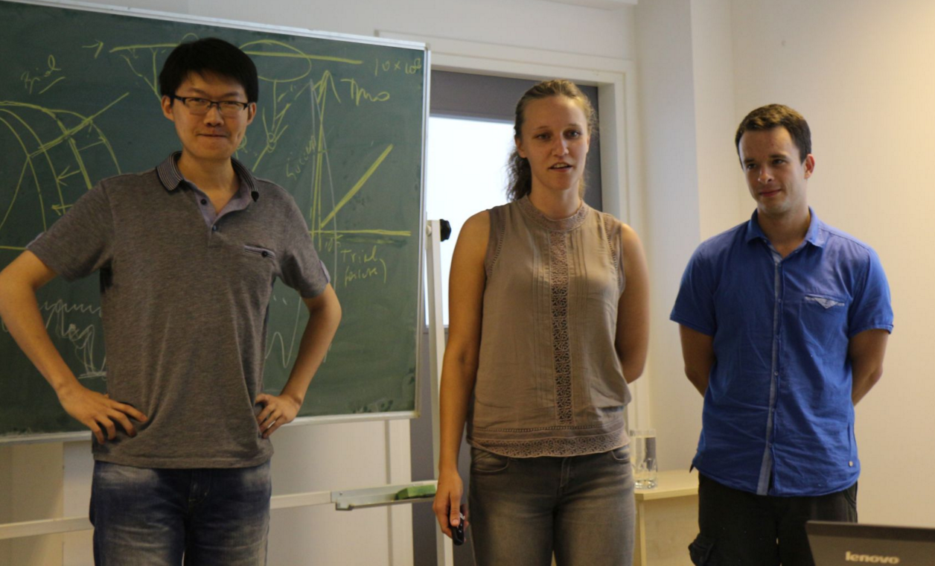



RSSSO 2015 Random Forest Team
Zheng Ning
German Demidov
Maja Fabijanić
Project leaders:
dr. Julia Dimitrieva
(+ husband dr. Dmitri Filippov)
mr. Alexander Kurilshikov
dr. Olga Zaitseva

Slide 49
The problem
Expression data for 20 tissues (~ 10 000 probes):
Illeum
CD4+
CD8+
…
Select important probes to predict:
BMI
Risk Scores for Ulcerative colitis
Risk Scores for Chron’s disease
The approach: LR, RF, MIC

Slide 50
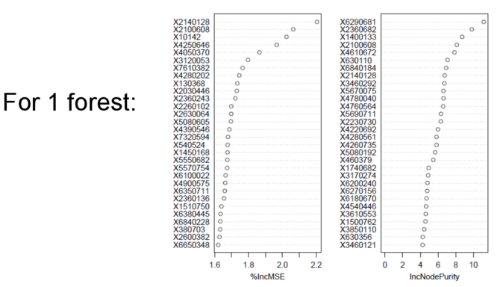
Permutation test for variable importance

Slide 51
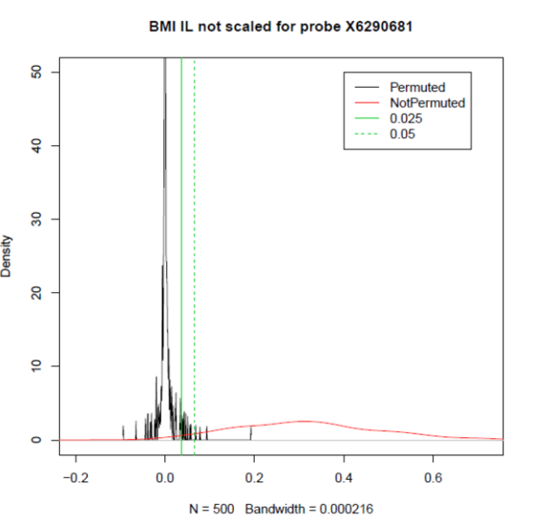
Permutation test for variable importance

Slide 52
Oops
Different variables each time!?
m for classification is 1/3*p, not sqrt(p)
Too slow RF (~20 minutes for 1)
RF formula!
Packages!

Slide 53
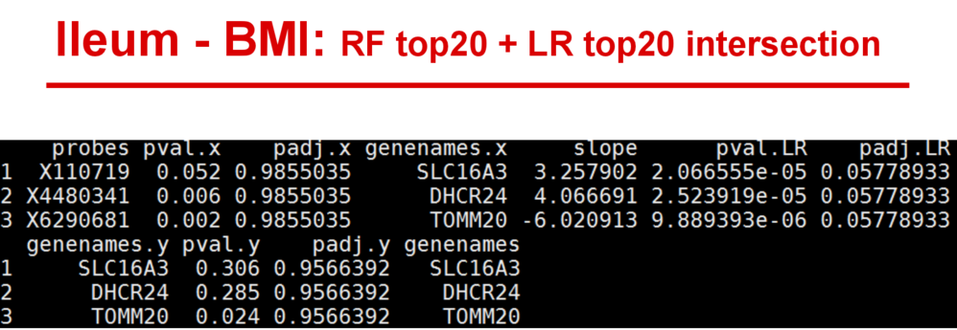

Slide 54
Conclusions
Be careful when selecting variables not to introduce bias (use unsupervised learning)
Do a valid cross-validation
Check your results (if they are too good to be true, they probably aren’t true)
Try a simpler approach first
You WILL make mistakes.
Use google. READ THE MANUAL.

Slide 55


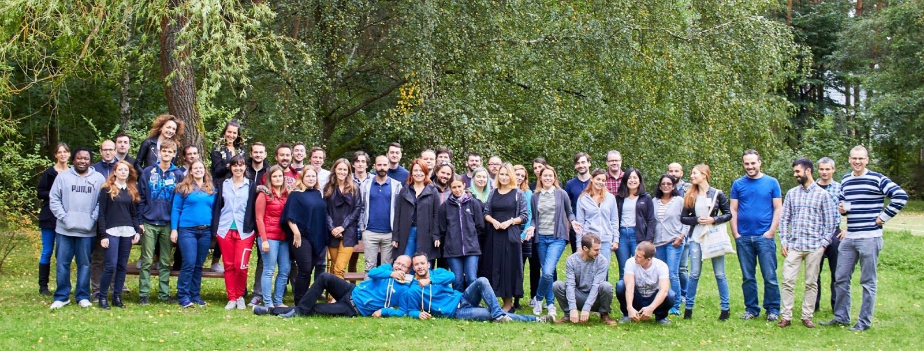
NGSchool 2017

Slide 56

NGSchool 2018

Slide 57


NGSchool 2019

Slide 58

Thank you for attention.

